Slide 1
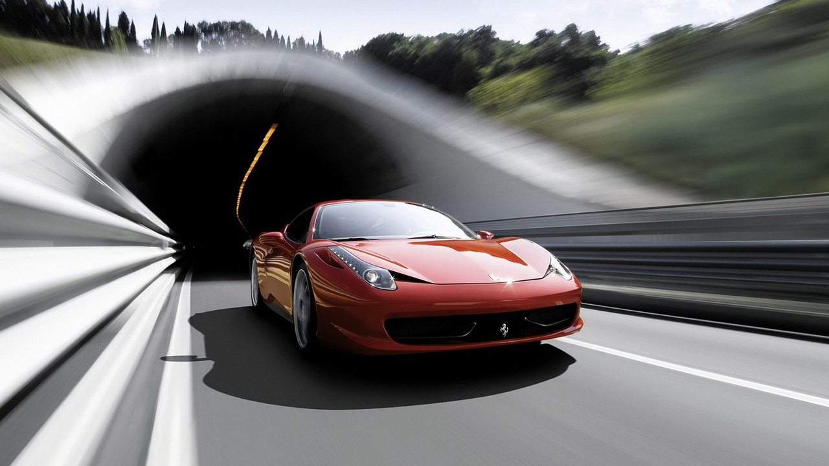
Impact of car features on price and profitability

Slide 2
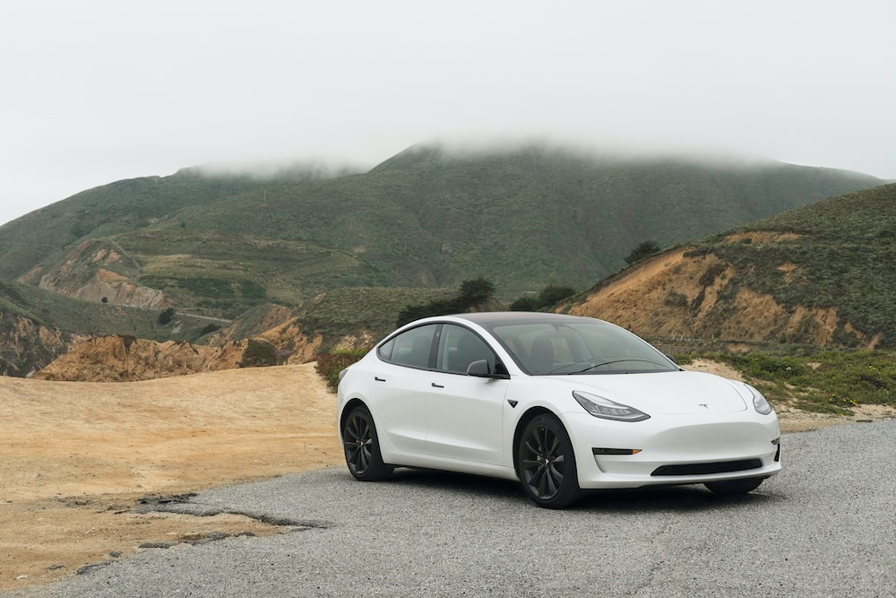





CONTEXT
PROJECT DESCRIPTION
TECH STACK USED
DASHBOARD
END
START
APPROACH
INSIGHTS
RESULT

Slide 3

PROJECT DESCRIPTION
The automobile industry has undergone significant changes in the past few decades, with a strong emphasis on technology advancement, environmental sustainability, and fuel efficiency. With this heavy competition among manufacturers and evolving consumer preferences, it is crucial to comprehend the driving forces behind car demand.
In recent times, there is a noticeable shift towards electric and hybrid vehicles, and the interest in alternative fuel sources like hydrogen and natural gas has increased. However, traditional cars still hold a major share of the market, with an array of fuel types and grades available to buyers.
The challenge is to determine the best pricing and product development strategies that satisfy consumer demand while optimizing profits for the carmaker.

Slide 4
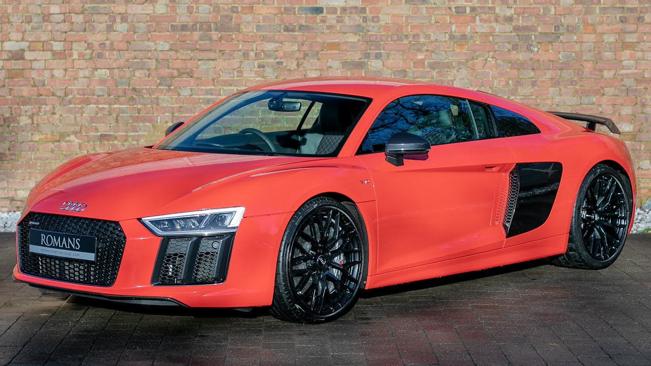

APPROACH
One way to solve this issue is to examine how a car's characteristics, market classification, and costs are interconnected. The aim is to pinpoint which features and categories are most preferred by customers and generate the most profit for the producer. By employing data analysis methods like regression and market segmentation, the producer can create a pricing plan that takes into account both consumer demand and profitability. Furthermore, the producer may utilize this data to determine which product features to emphasize in upcoming product development initiatives. This can aid in the manufacturer's market competitiveness and improve profitability in the long run.

Slide 5



TECH STACK USED
Microsoft Excel
PowerPoint

Slide 6

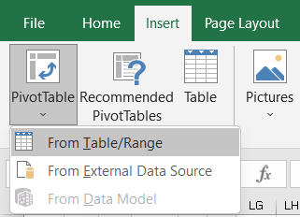
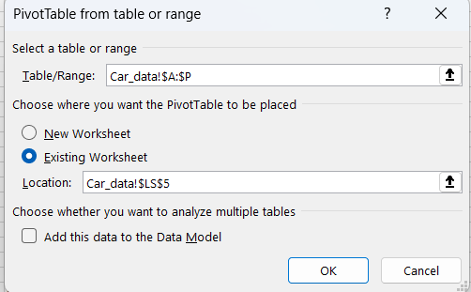
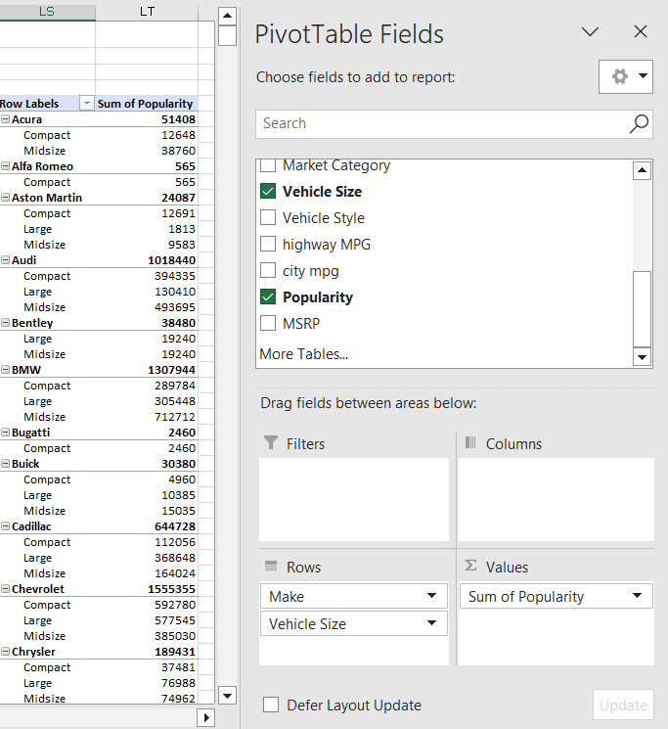
HOW TO CREATE A PIVOT TABLE
A Pivot Table is an interactive way to quickly summarize large amounts of data. You can use a Pivot Table to analyze numerical data in detail and answer unanticipated questions about your data.
STEPS TO CREATE PIVOT TABLE
Select the range from the given table to insert the pivot table
Select the desired columns, you can drag them to values, rows, columns
Insert the pivot table from the insert tab

Slide 7
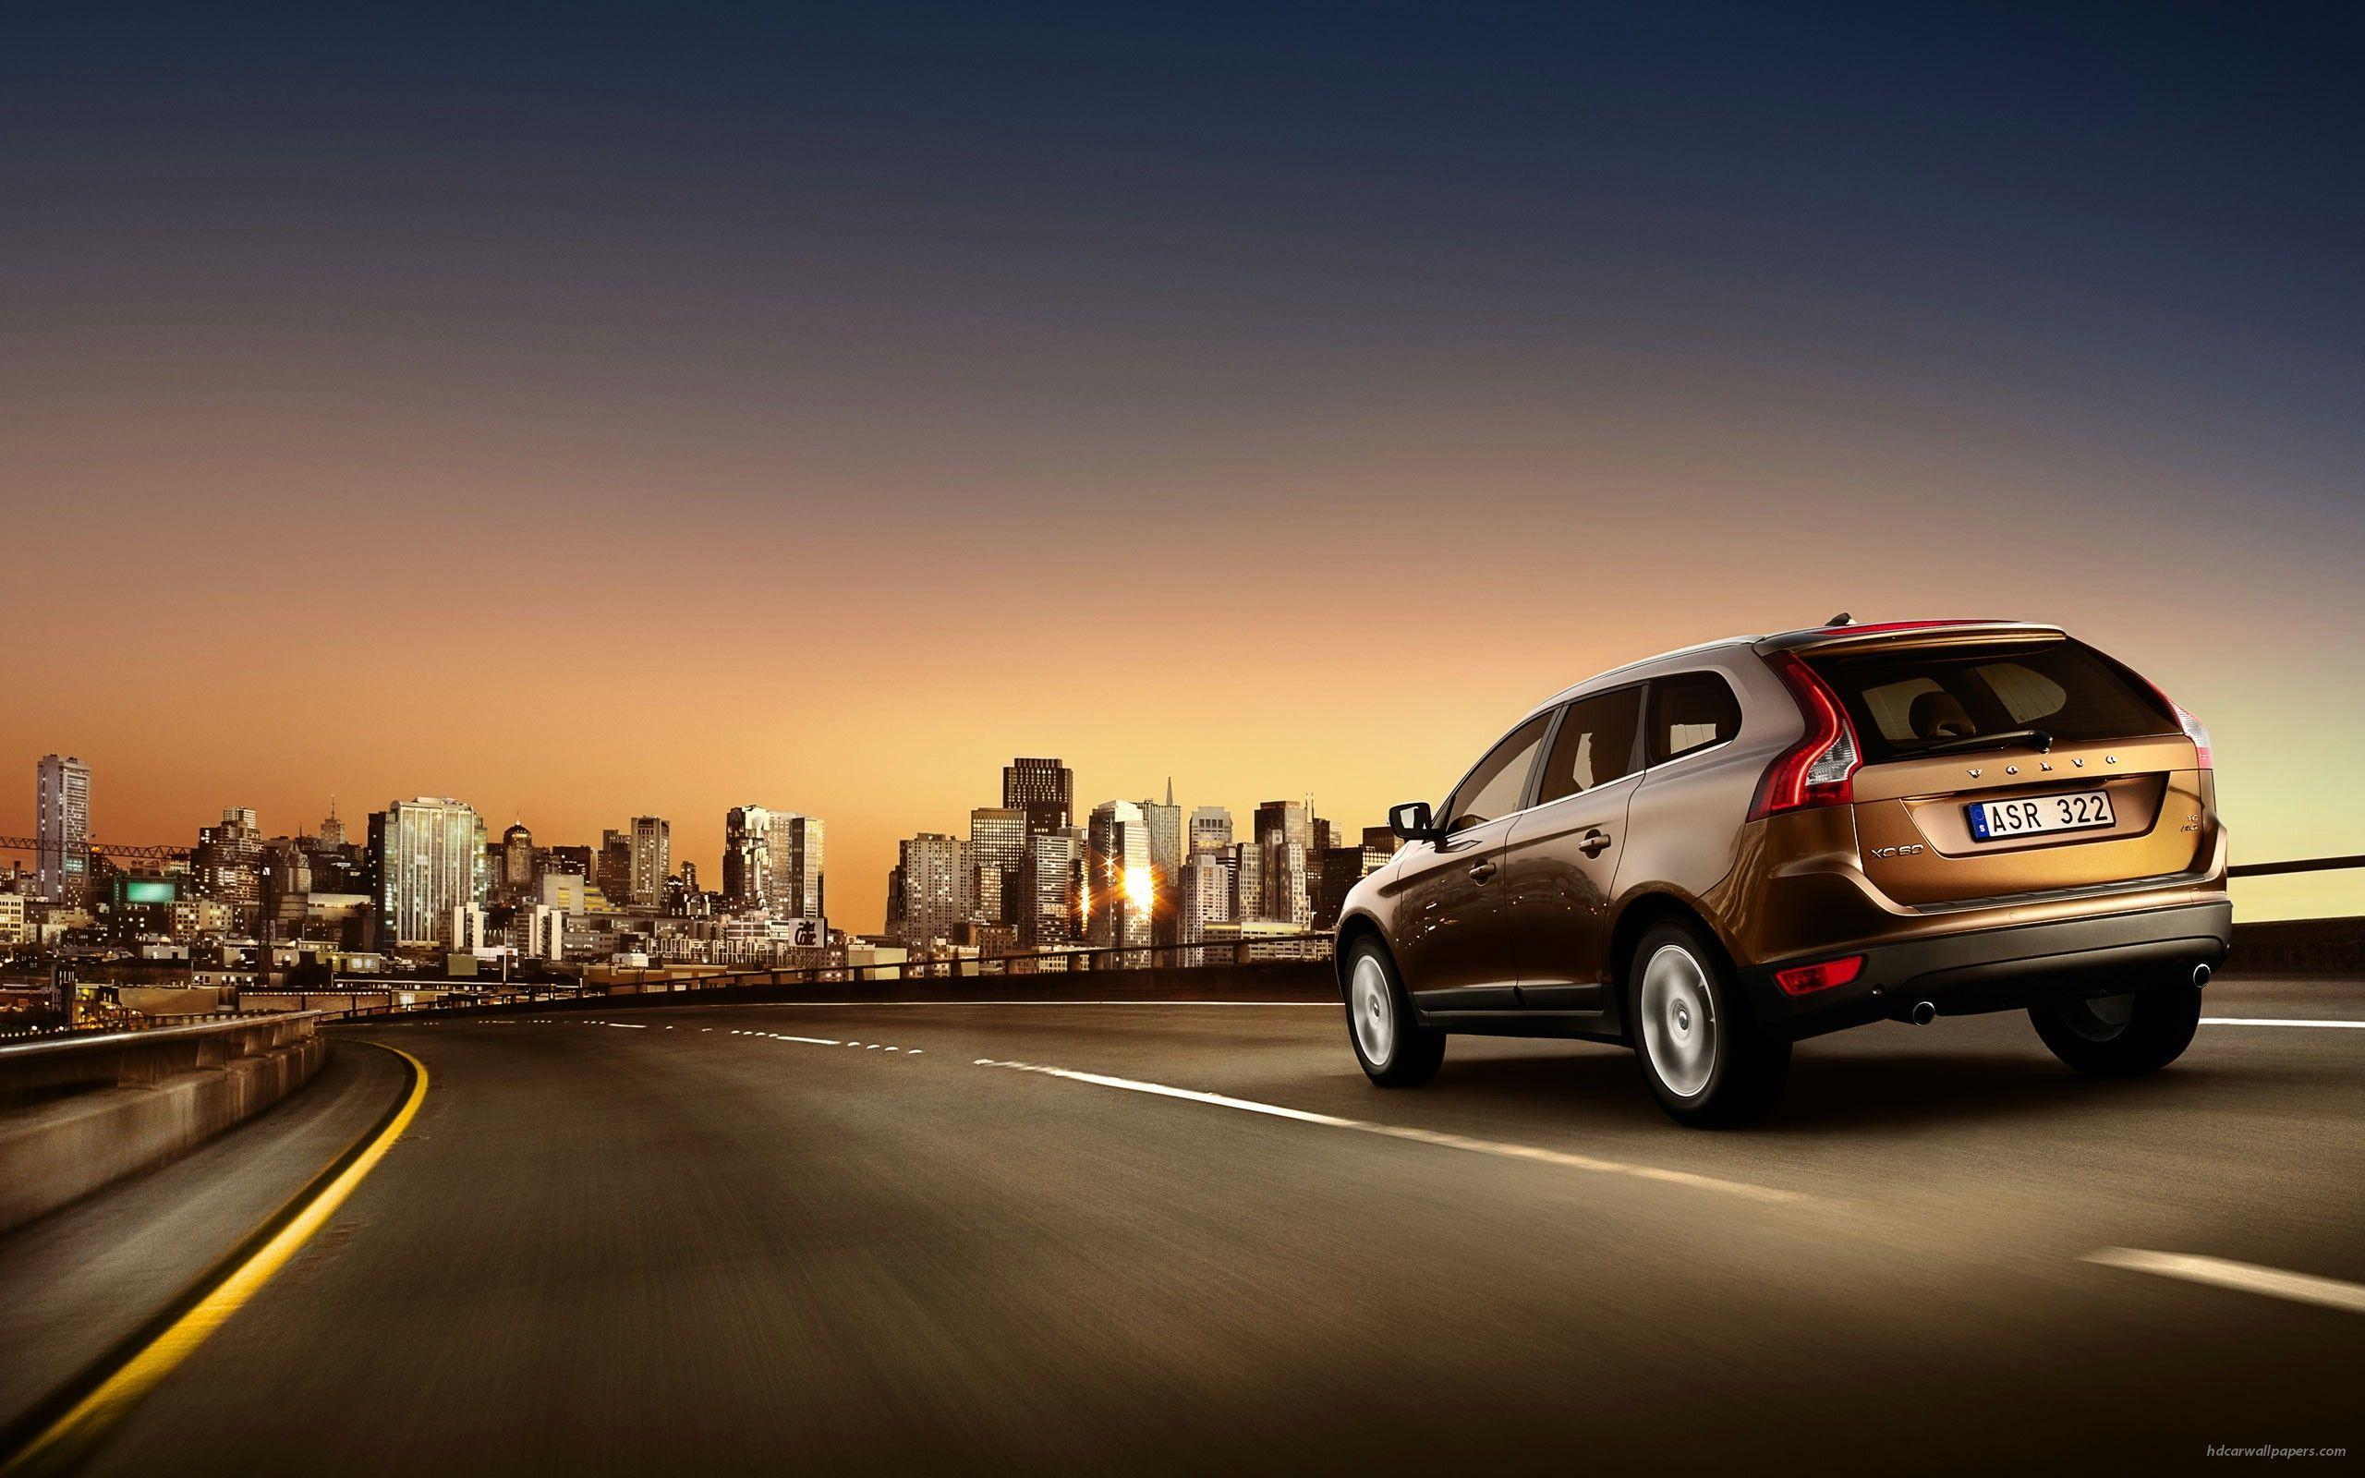
ANALYSIS

Slide 8

THE POPULARITY OF A CAR MODEL VARIES ACROSS DIFFERENT MARKET CATEGORIES
To begin, we must generate a pivot table to display the number of car models within each market category along with their respective popularity scores.
The columns selected for this table are car models, market categories, and popularity.
Once the pivot table is generated, it will display all car models sorted by their market categories, along with the total popularity score for each car model across the entire table.
You may access the link to the created pivot table here.
pivot table that shows no car models in each market category and the sum of the popularity

Slide 9
THE POPULARITY OF A CAR MODEL VARIES ACROSS DIFFERENT MARKET CATEGORIES
Our goal is to create a chart that demonstrates the correlation between market and popularity.
This requires two sets of numerical data, and I have included MSRP (price) as the second set.
For your convenience, I have provided a link to the pivot table that includes the market category, popularity, and price.
pivot table which shows market category, popularity, and price

Slide 10
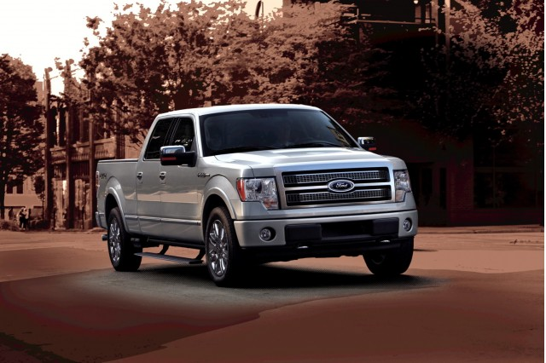
THE POPULARITY OF A CAR MODEL VARIES ACROSS DIFFERENT MARKET CATEGORIES
After going through these two tasks, we need to find out which car models are popular in different market categories, and their popularity.
I have created a pivot table stating which car models have the highest popularity in each market category.
You may access the link to the created pivot table here.
diff car models with the highest popularity in each market category
The highest popularity model is F 150 in the flex-fuel market category.

Slide 11
RELATIONSHIP BETWEEN A CAR’S ENGINE POWER AND A CAR’S PRICE
I have generated a scatter plot that displays the correlation between engine power and price.
By placing engine power on the x-axis and price on the y-axis, I was able to discern a trendline that illustrates the relationship between the two variables.
The upward trendline suggests that as engine power increases, so does the price of the car.
Based on this analysis, I can confidently conclude that engine power significantly impacts a car’s price.

Slide 12
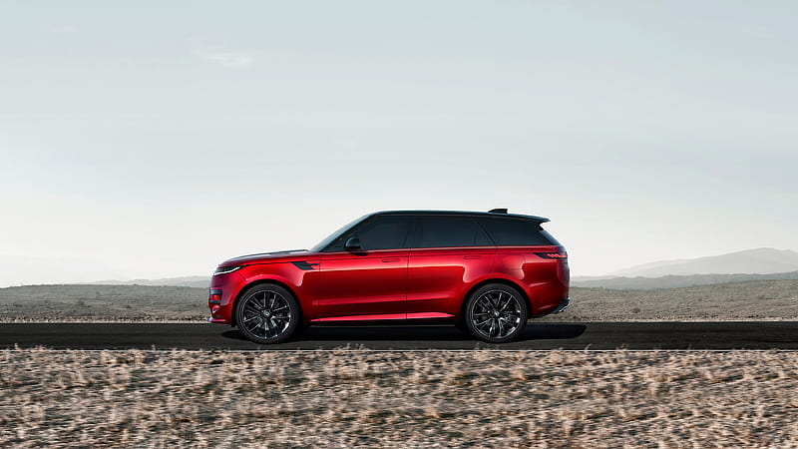
A CHARACTERISTIC THAT IMPACTS THE CAR’S PRICE
I have utilized regression analysis to determine which factors are most closely linked to a car’s cost.
In order to identify these factors, we must first calculate the correlation coefficient.
I have compiled a table that displays the correlation coefficients of all variables that are associated with the price.
VARIABLES | VALUES
ENGINE HP | 0.66
ENGINE CYLINDER | 0.53
NO OF DOORS | -0.13
HIGHWAY MPG | -0.16
CITY MPG | -0.16
POPULARITY | -0.05
The formula for the correlation coefficient is
correlation coefficient=
covariance/(SD of 1st variable * SD of 2nd variable)
The formula for covariance is
=COVARIANCE.P(range of 1st column, range of 2nd column)
The formula for standard deviation is
=STDEV.S(range of column)

Slide 13
A CHARACTERISTIC THAT IMPACTS THE CAR’S PRICE
I have created a bar chart to know the factor which is influencing the car’s price.
Here we can see the engine’s power is the most influential factor to decide the car’s price.
The least influential factor is MPG which is miles per gallon.
Also I have created a data table down the chart for clarification.

Slide 14

HOW DOES THE AVG PRICE OF A CAR FLUCTUATE AMONG VARIOUS CAR MAKERS
We aim to determine the variation in the manufacturer’s car prices among different manufacturers.
To achieve this, I have accomplished two tasks.
The first task involved generating a pivot table that displays the average car prices for every manufacturer.
Then, I proceeded to create a bar chart that provides a graphical representation of the correlation between the manufacturer and the average price.
The initial step was to create a pivot table that computes the average car prices for each manufacturer.
I have taken car brand and MSRP columns to create the pivot table.
Here is the link to the pivot table
pivot table for avg price of a car manufacturer

Slide 15
HOW DOES THE AVG PRICE OF A CAR FLUCTUATE AMONG VARIOUS CAR MAKERS
Here, we can see the car model with the highest average price is Bugatti with $ 17,57,223.67.
The car model with the lowest average price is Plymouth with $ 3,122.90.
In the below chart, we can see the variation in average prices of different car manufacturers.

Slide 16
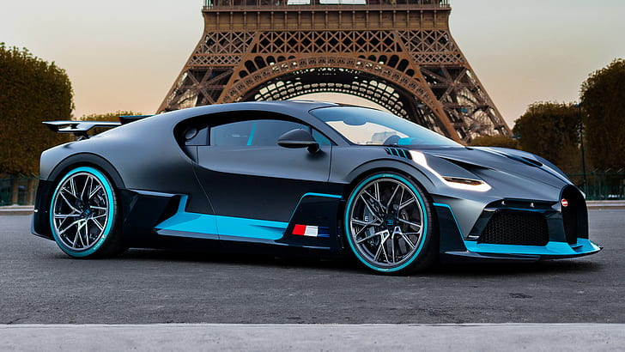
RELATIONSHIP BETWEEN FUEL EFFICIENCY AND NO OF CYLINDERS IN CAR’S ENGINE
To determine the correlation between fuel efficiency and the number of cylinders in a car's engine, we can create a scatter plot to understand if the trend is positive or negative.
Additionally, calculating the correlation coefficient will help measure the strength and direction of the relationship between the number of cylinders and highway MPG.
From the chart, we can observe that the trendline is sloping downwards, indicating that if the number of cylinders increases, the highway MPG will decrease, hence, resulting in lower miles per gallon.

Slide 17
RELATIONSHIP BETWEEN FUEL EFFICIENCY AND NO OF CYLINDERS IN A CAR’S ENGINE
To determine the correlation between fuel efficiency and the number of cylinders in a car's engine.
Calculating the correlation coefficient will help measure the strength and direction of the relationship between the number of cylinders and highway MPG.
The value of the correlation coefficient is -0.60
It indicates that the direction is going down and strength is weak.

Slide 18

DASHBOARD

Slide 19
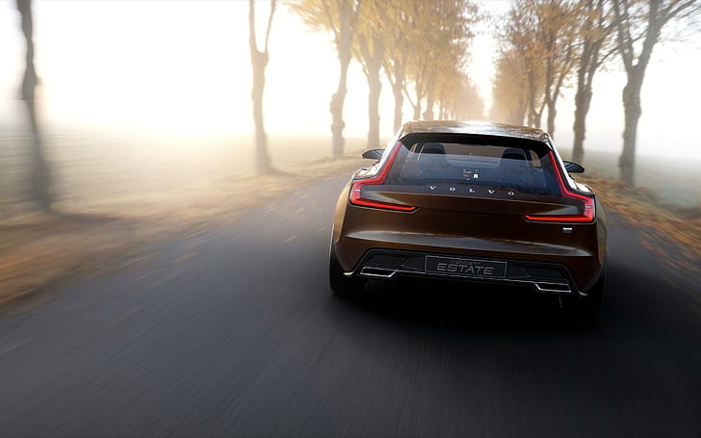
DASHBOARD
Here is the link to the dashboard in Excel which I have created with slicers, links, and filters.
Dashboard for impact of car features on price and profitability

Slide 20
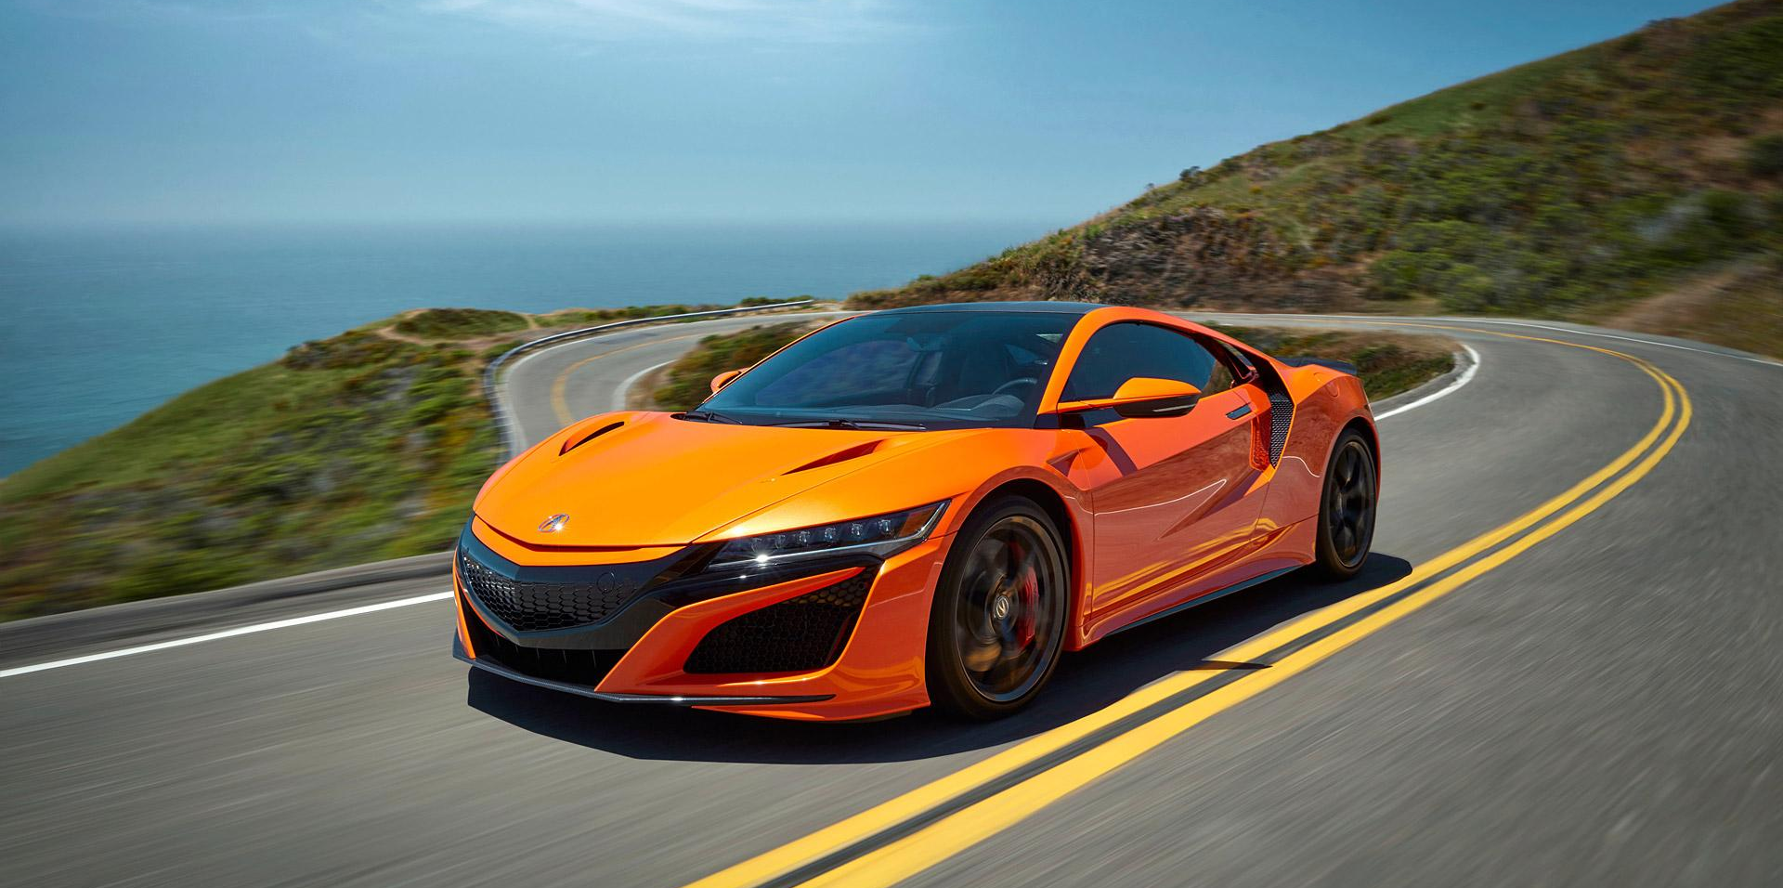
RESULT
This project's analysis of car features, average prices, popularity, and more is crucial.
The use of pivot tables and pivot charts has made this task more comprehensible.
This project has given me a practical exposure to pivot tables, charts, and dashboards and how the product features will impact on price and profits in real business world.

Slide 21


THANK YOU

